Slide 1


Genital HSV-1 Infections:
New and Emerging Research
Christine Johnston, MD, MPH
Herpes Cure Advocacy
March 5, 2024

Slide 2
Disclosures
UpToDate: Royalties
Consulting: GSK, Assembly Biosciences
Grants: Moderna, GSK
Herpes Cure Advocacy (non-profit): Medical Advisory Board

Slide 3

Acknowledgments
Dedicated participants
Public Health-Seattle & King County STD Clinic
Funding:
NIH/NIAID P01 AI030731
Amalia Magaret
Michael Stern
Hyunju Son
Meei-li Huang
Stacy Selke
Keith Jerome
David Koelle
Sarah Gunby
Mariliis Ott
Lichen Jing
Victoria Campbell
Alex Greninger
Moriah Szpara
Molly Rathbun
Daniel Renner
Anna Wald
Larry Corey

Slide 4
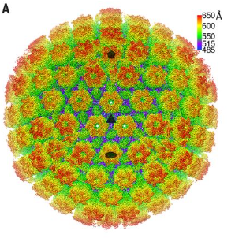
Herpes Simplex Virus: A very challenging STI
Genital herpes is caused by HSV-1 or HSV-2
  Leading cause of genital ulcer disease worldwide
Chronic, no cure
  Management of symptoms
  Transmission concerns
Often asymptomatic/subclinical
  Requires reliance on blood tests to diagnose infection
  Intensive shedding studies define natural history, therapeutics
Disparities: Higher prevalence in women, racial and sexual minority populations
Few diagnostic or therapeutic advances that have affected clinical care in past decade
Dai and Zhou Science 2018

Slide 5

Genital herpes is a stigmatized condition
Causes anxiety for patients and providers
Poor knowledge about infection among providers, a lot of misinformation on the web
Often maligned/made fun of in media and popular culture
Motivates researchers and research participants
  Knowledge is power
Time “H”

Slide 6

University of Washington Virology Research Clinic
Founded in 1973 to study chronic viral infections, specifically HSV
Natural history studies
Clinical trials
  Antivirals, vaccines, clinical trial design
Diagnostics
Counseling and safe space for people with genital HSV infection

Slide 7
Genital HSV-1: Epidemiology
Increasing cause of first episode genital herpes in high income countries
HSV-1 is a significant cause of GUD worldwide
  9 million people
Declining HSV-1 seroprevalence in US, particularly in adolescents
  First exposure to HSV-1 upon sexual debut
Modeling: By 2050, increasing proportion of HSV-1 infections will be acquired genitally
  This will affect adolescents and young adults
Durukan et al, STI 2019
Dabestani et al, STD 2019
Looker et al, BMJ Global Health 2020
Bradley et al, JID 2014
Ayoub et al, BMJ Med 2019

Slide 8
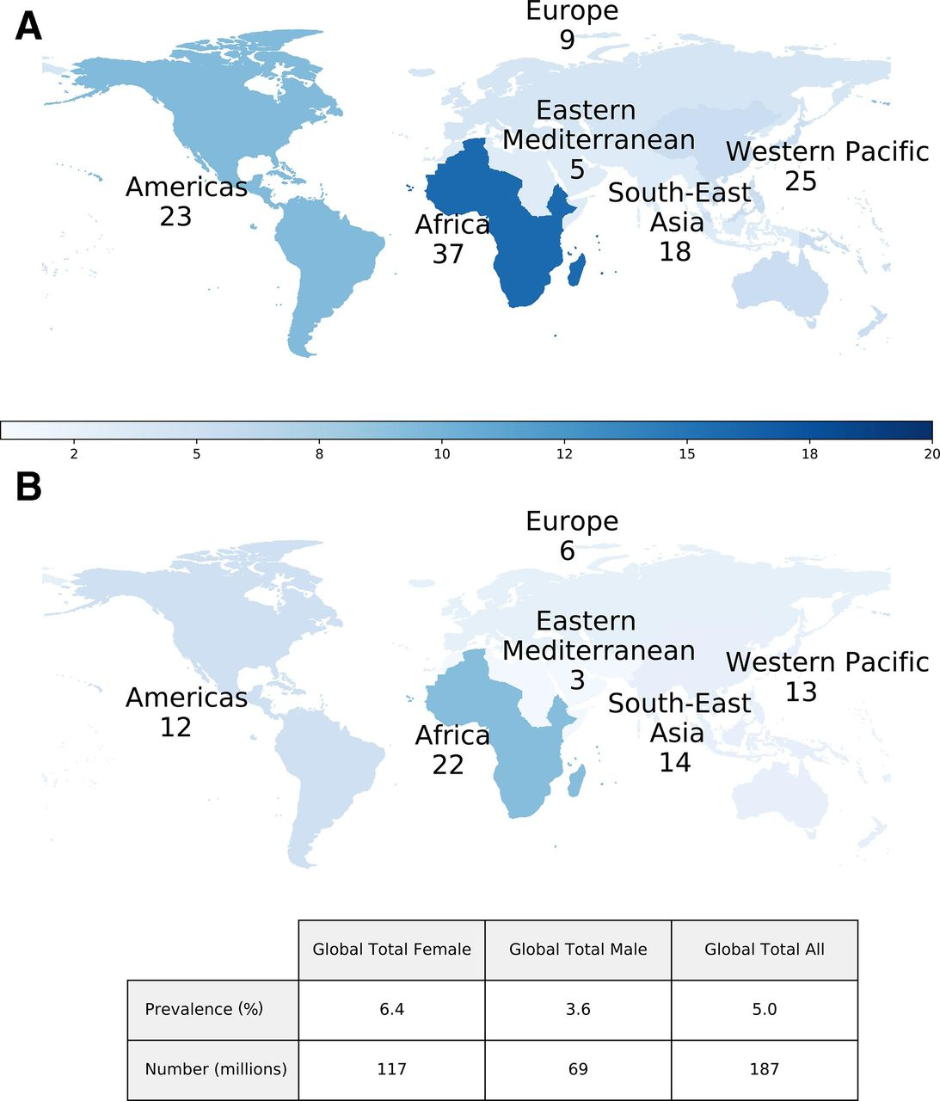
Epidemiology and Burden: HSV-related GUD in 2016
Women
Men
HSV-2: 178 million people
HSV-1: 9 million people
8 billion days with HSV-related GUD in 2016
Looker et al, BMJ Global Health 2020

Slide 9
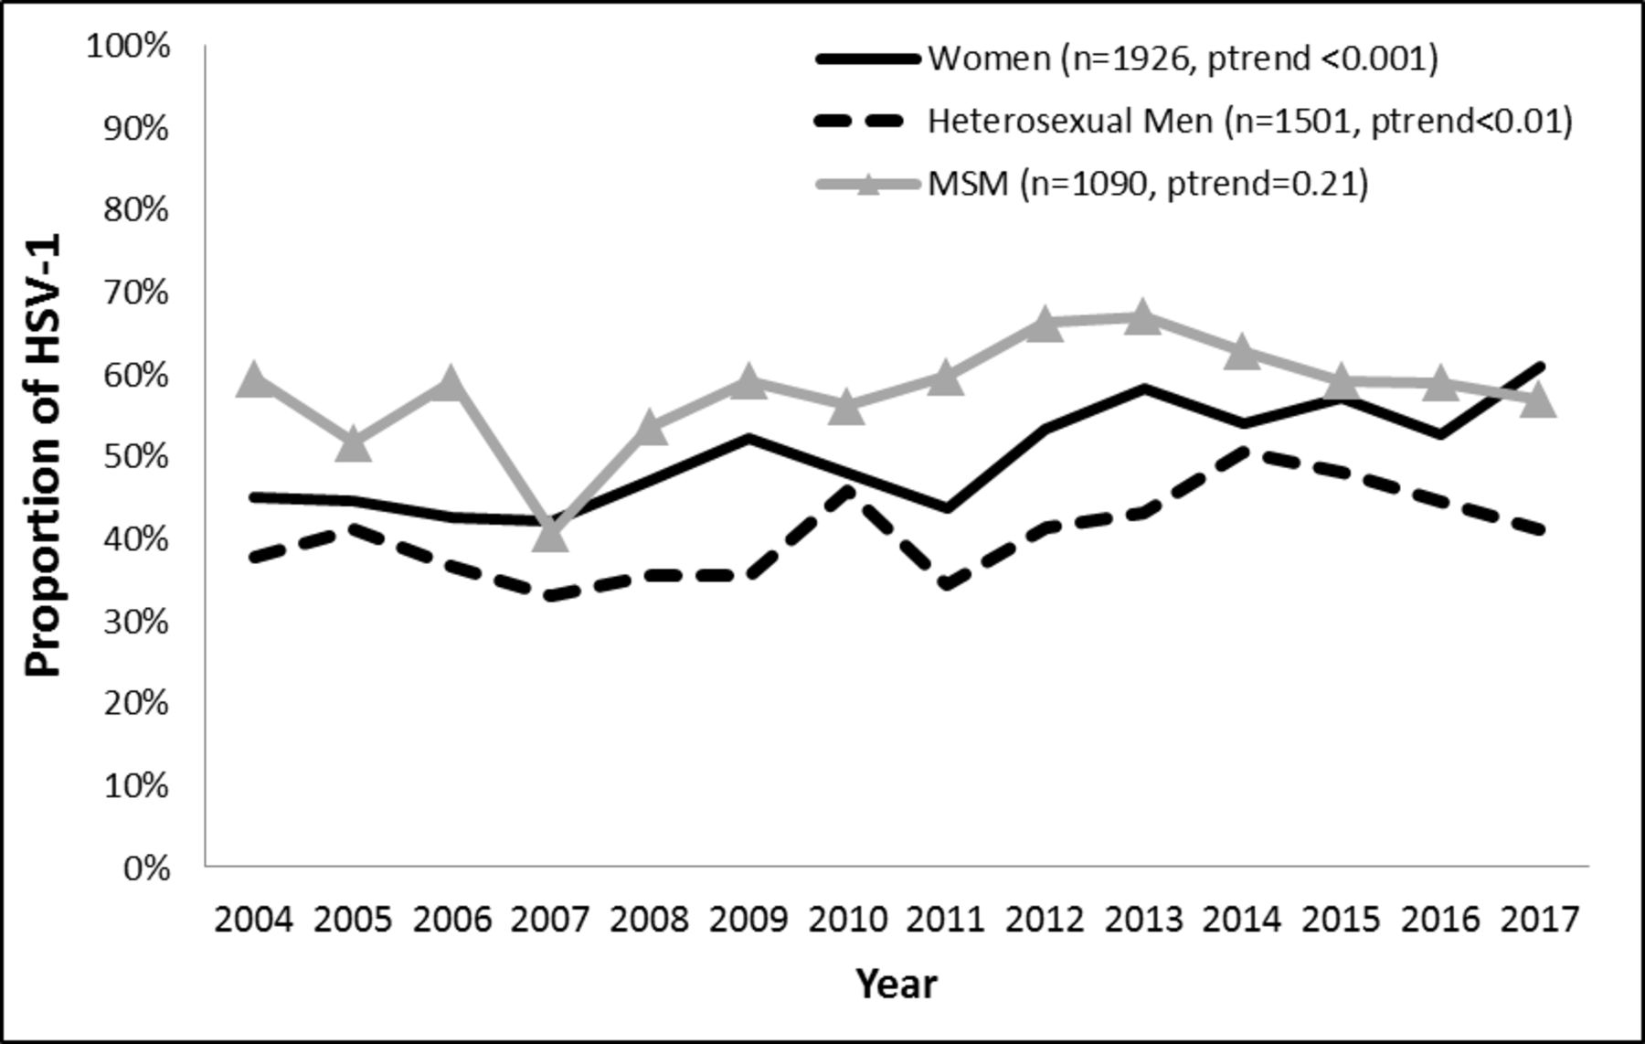
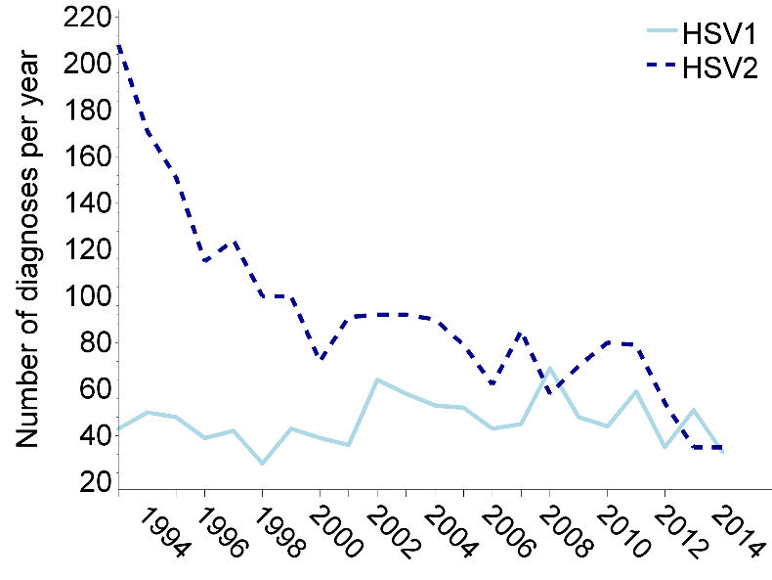
Changing epidemiology of first episode genital herpes
Melbourne Sexual Health Center
Public Health-Seattle & King County
In 2017, 54% of first episode genital herpes was due to HSV-1
Each decade, 52% increase in proportion
of first episode genital HSV-1
Durukan STI 2019
Dabestani, STD 2019

Slide 10
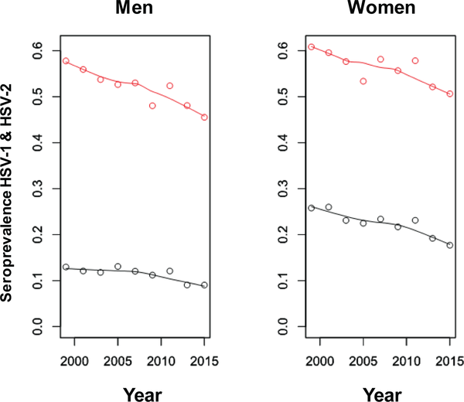
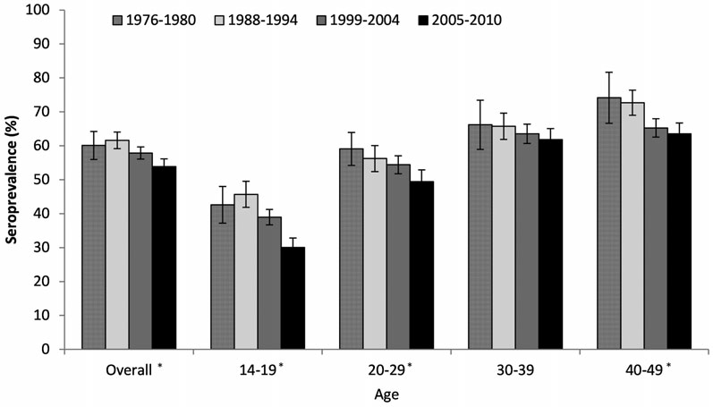
Trends in HSV seroprevalence in the United States, 1999–2015
7% decline
29% decline
Bradley et al, J Inf Dis 2014; 209: 325-33.
Chemaitelly H, Nagelkerke N, Omori R, Abu-Raddad LJ (2019) PLOS ONE 14(6): e0214151. https://doi.org/10.1371/journal.pone.0214151

Slide 11
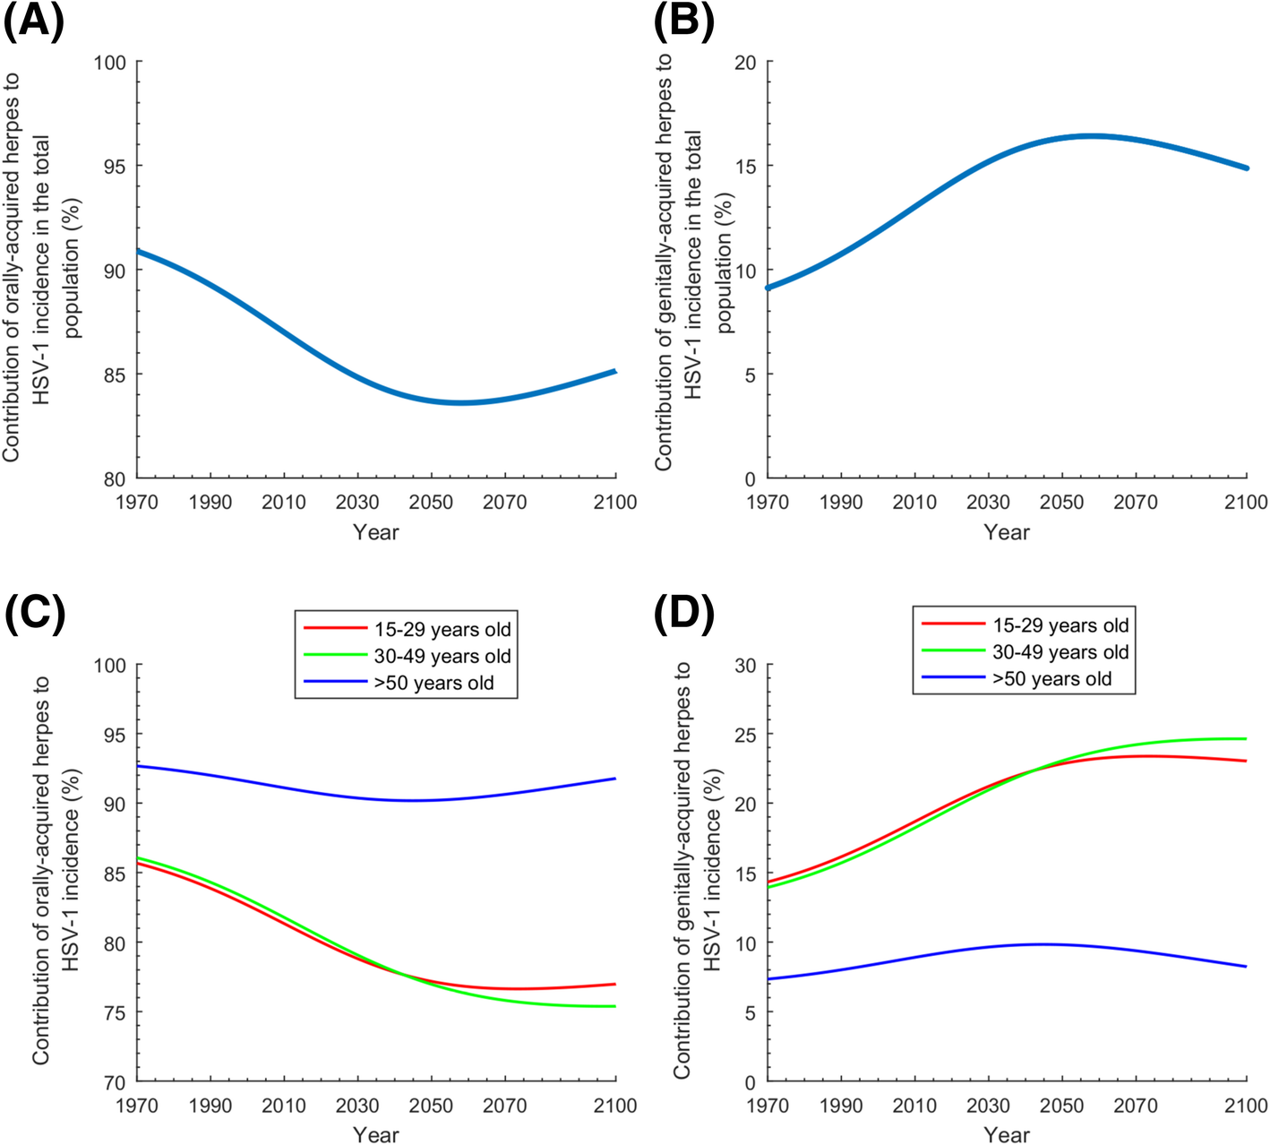
“Epidemiologic Transition” of HSV-1 infection
Modeling: By 2050, increasing proportion of HSV-1 infections will be acquired genitally
This will affect adolescents and young adults
Ayoub et al, BMJ Med 2019

Slide 12
Genital HSV-1: Clinical Presentation
  Primary infection can be severe and may involve both genital and oral lesions
  Recurrences are less frequent than with HSV-2
  As with HSV-2, genital HSV-1 is associated with neonatal HSV, particularly when it is acquired during pregnancy
  Available shedding data measured with culture rather than more sensitive PCR
    Unknowns:
      Frequency of genital shedding
      Frequency of oral shedding
      How shedding changes over time
    Implications for patient counseling and transmission to sex partners
Engelberg et al, STD 2003
Reeves et al, NEJM 1991
Benedetti et al, Ann Int Med 1999
Kim et al, JID 2006

Slide 13

HSV : A systems biology approach
HOST
VIRUS
Genital/Oral swabs
Shedding rate
Viral quantity
Modeling
Genome sequencing
Blood
Genetics
Immune response
CD4, CD8
Antibody
CLINICAL
Genital Tissue
Immune response
CD4, CD8
Single Cell analysis
RNA – microarray
Daily diary
Symptomatic
Asymptomatic
ENVIRONMENT
Cervicovaginal
Cytokines
Innate immunity
Co-infections
HIV
CMV, EBV
HPV
Microbiome
Behavioral
Questionnaires

Slide 14



First episode genital HSV-1 study design
Daily oral and genital swabs for HSV PCR
Blood for serologic and immune assays
First episode
Symptomatic
Genital HSV-1
Monthly survey: self-reported oral and genital recurrences
Time 0 2-3 month 6 months 11-12 months 2 years or more
“Session 1” “Session 2” “Session 3”
Transmitting
Partner
Key inclusion/exclusion criteria
*no prior history of genital herpes
*PCR swab or culture from genital tract lesion positive for HSV-1
*HIV-1 seronegative
30 day oral and genital swabs

Slide 15
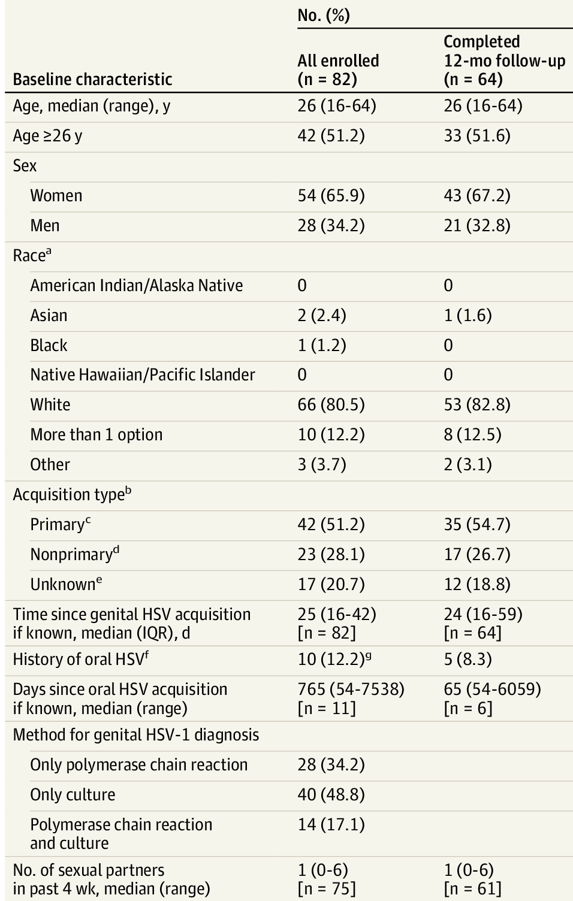
Study Demographics
Definitions:
Primary: HSV-1 seronegative
Non-primary: HSV-1 seropositive at baseline
Unknown: Blood drawn 42 days after first episode symptoms or seroconversion not observed
Johnston et al, JAMA 2022

Slide 16
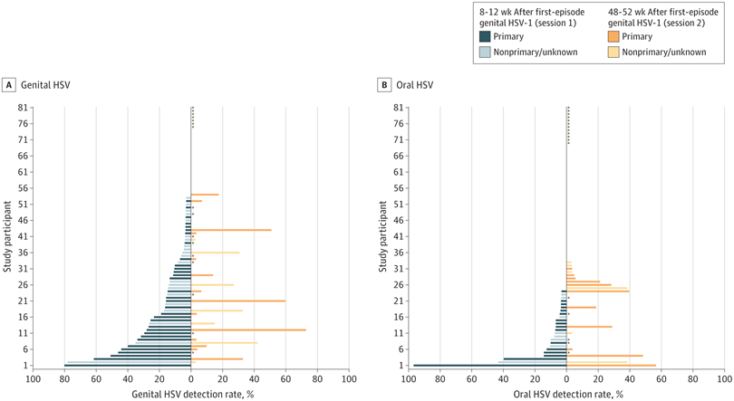
Genital HSV-1: Per-person shedding rates
Overall Genital
Shedding Rate:
Session 1: 12.1%
Session 2: 7.1%
Overall Oral
Shedding Rate:
Session 1: 3.9%
Session 2: 5.1%
Johnston et al, JAMA 2022

Slide 17
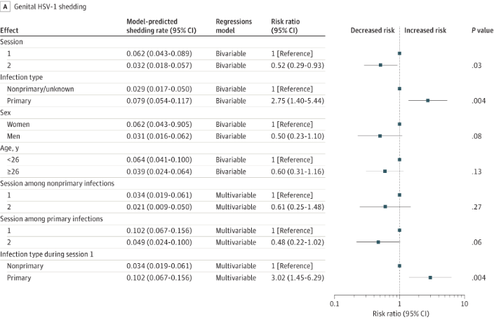
Risk factors for HSV-1 genital shedding
No risk factors for HSV-1 oral shedding identified in multivariable model

Slide 18
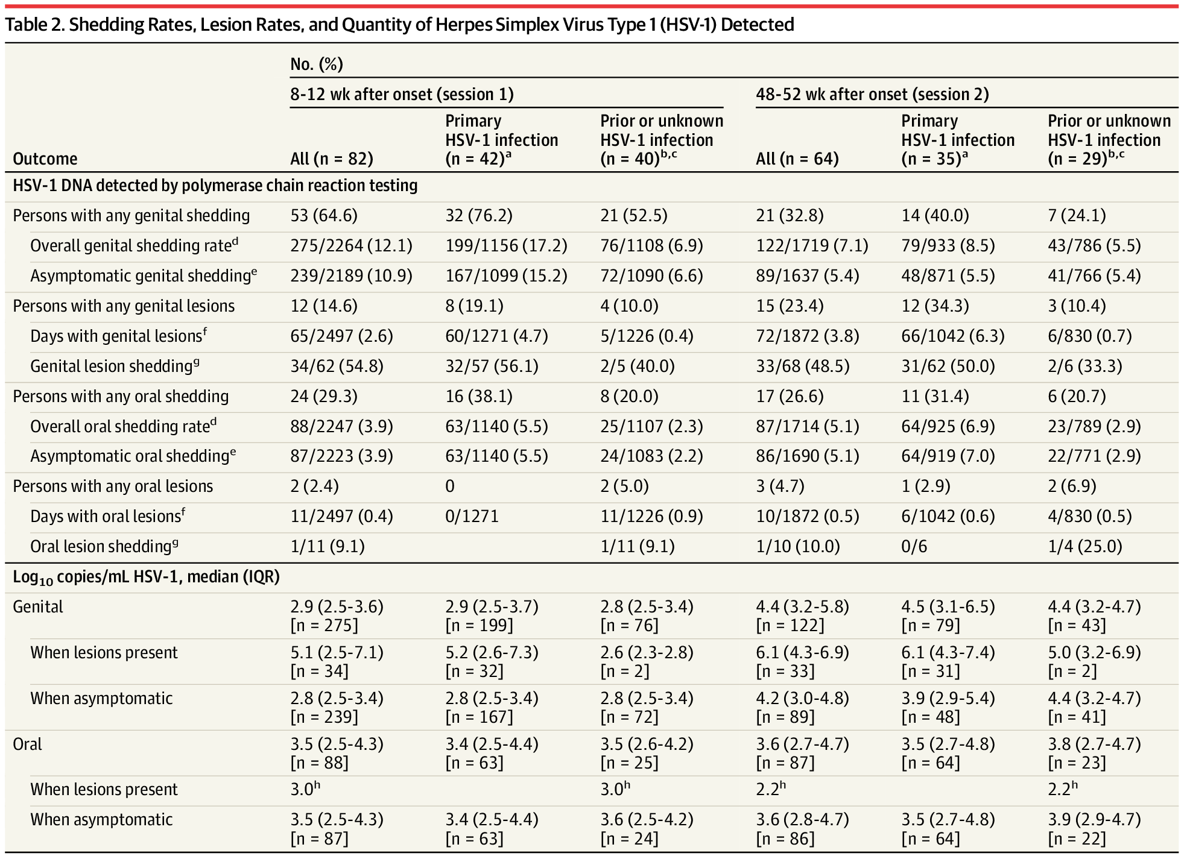

Slide 19
Risk factors for HSV-1 genital shedding
No risk factors for HSV-1 oral shedding identified in multivariable model

Slide 20
Genital Shedding Rate: HSV-2 vs. HSV-1
Time since <1 year <10 year ≥10 years Unknown
acquisition
Johnston et al, ISSTDR 2019
Phipps et al, JID 2011
Tronstein et al, JAMA 2011

Slide 21
Genital and Oral lesions
Genital Lesion Rate: Session 1: 2.6% of days
Session 2: 3.8% of days
Risk factor for Genital Lesions:
Primary acquisition: RR=6.5 (95% CI-2.4-17.8), p<0.001
Oral Lesion Rate: Session 1: 0.4% of days
Session 2: 0.6% of days

Slide 22
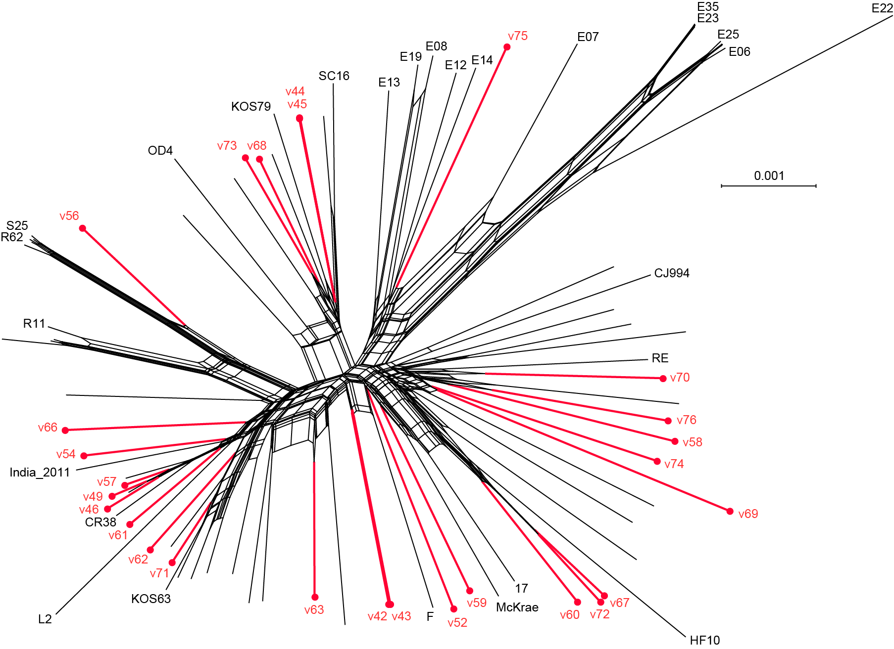
Genital HSV-1 genomes are distributed among the previously known genetic diversity of HSV-1
Red=Genital HSV-1 cultured specimens
Molly Rathbun & Moriah Szpara

Slide 23
Genital HSV-1: Frequently asked questions
I took a blood test for HSV-1 infection. It’s positive. How can I tell if I have HSV-1 infection in the oral or genital area?

Slide 24
Genital HSV-1: Frequently asked questions
If I have genital HSV-1 infection, do I also have oral infection? Can I pass the virus on with kissing/oral sex?

Slide 25
Genital HSV-1: Frequently asked questions
I just had my first genital herpes outbreak. I had a positive HSV-1 swab from the lesion. Should I tell my sexual partners that I have genital HSV-1 infection?

Slide 26
Genital HSV-1: Frequently asked questions
Should I use daily suppressive therapy to prevent recurrences or shedding with genital HSV-1 infection? How about transmission to sexual partners?

Slide 27
Genital HSV-1: Frequently asked questions
Do we have any medication alternatives to acyclovir/valacyclovir/famciclovir for treatment of genital herpes?

Slide 28
Genital HSV-1: Frequently asked questions
Am I protected against genital HSV-2 infection if I have genital HSV-1 infection?

Slide 29
Genital HSV-1: Frequently asked questions
I’ve heard that HSV-2 infection is associated with an increased risk of acquiring HIV infection. Is the same true for genital HSV-1 infection?

Slide 30
Genital HSV-1: Frequently asked questions
I have genital HSV-1 infection. What are the risk factors for transmission to neonates/babies at the time of delivery?

Slide 31
Genital HSV-1: Frequently asked questions
I’ve heard that there might be a link between HSV-1 infection and neurodegenerative diseases/Alzeheimer’s Disease. What is known about genital HSV-1 infection and neurodegenerative diseases?

Slide 32
Genital HSV-1: Frequently asked questions
My partner has genital HSV-1 infection. How can I protect myself?

Slide 33
Genital HSV-1: Frequently asked questions
Why don’t we have a vaccine to prevent against genital HSV-1? Will we ever have one?

Slide 34
Genital HSV-1: Frequently asked questions
Why isn’t more being done to prevent genital herpes infection?

Slide 35
Conclusions
Primary genital HSV-1 infection is associated with more recurrences and shedding than non-primary infection
  Should this prompt serology with diagnosis, for prognostic purposes?
  Could this inform who should be offered suppressive therapy?
Genital HSV-1 shedding is less frequent than HSV-2 shedding
  Underscores importance of typing genital lesions for patients
Concerns about HSV-1 acquisition in pregnancy/neonatal HSV-1
Immune correlates associated with control of shedding and recurrences remain elusive

Slide 36
Questions? cjohnsto@uw.edu

